Slide 1
AI Tools Essential for Engineering Students
Academia Session · Learn · Organize · Recall · Plan · Research
FACILITATORS: SHREYASREE MATH & RIDA ARSHAD

Slide 2
Session Objective
Learn Concepts
Study Materials
Break down difficult topics with AI-powered explanations
Upload PDFs, PPTs & notes for AI-assisted study
Notes & Flashcards
Practice & Plan
Create structured revision notes and flashcard sets
Self-assess with quizzes, plan academics, explore research

Slide 3
AI Tools We Will Explore
NotebookLM
StudyFetch
Gemini Gems
Notion
Learn from uploaded materials, ask questions, summarize
AI-assisted learning, explanations & personalized study
Personalized academic productivity assistant
Academic organization, schedules & task tracking
Quizlet
RemNote
ResearchRabbit
Elicit
Flashcards, quizzes & active recall
Structured notes, flashcards & spaced repetition
Research discovery & paper connections
Literature discovery & paper analysis

Slide 4


NotebookLM
StudyFetch
Upload study material → Ask questions → Get summaries
Upload PDFs/PPTs → AI explains concepts → Extract key ideas
LIVE DEMO
Learn from Study Materials

Slide 5


LIVE DEMO
AI-Assisted Notes
NotebookLM
StudyFetch
Topic-wise summaries
Concise revision notes
RemNote
Linked study content

Slide 6


LIVE DEMO
Flashcards & Active Recall
Quizlet
Create flashcard sets, practice quizzes & test understanding
RemNote
Convert notes into flashcards with spaced repetition support

Slide 7
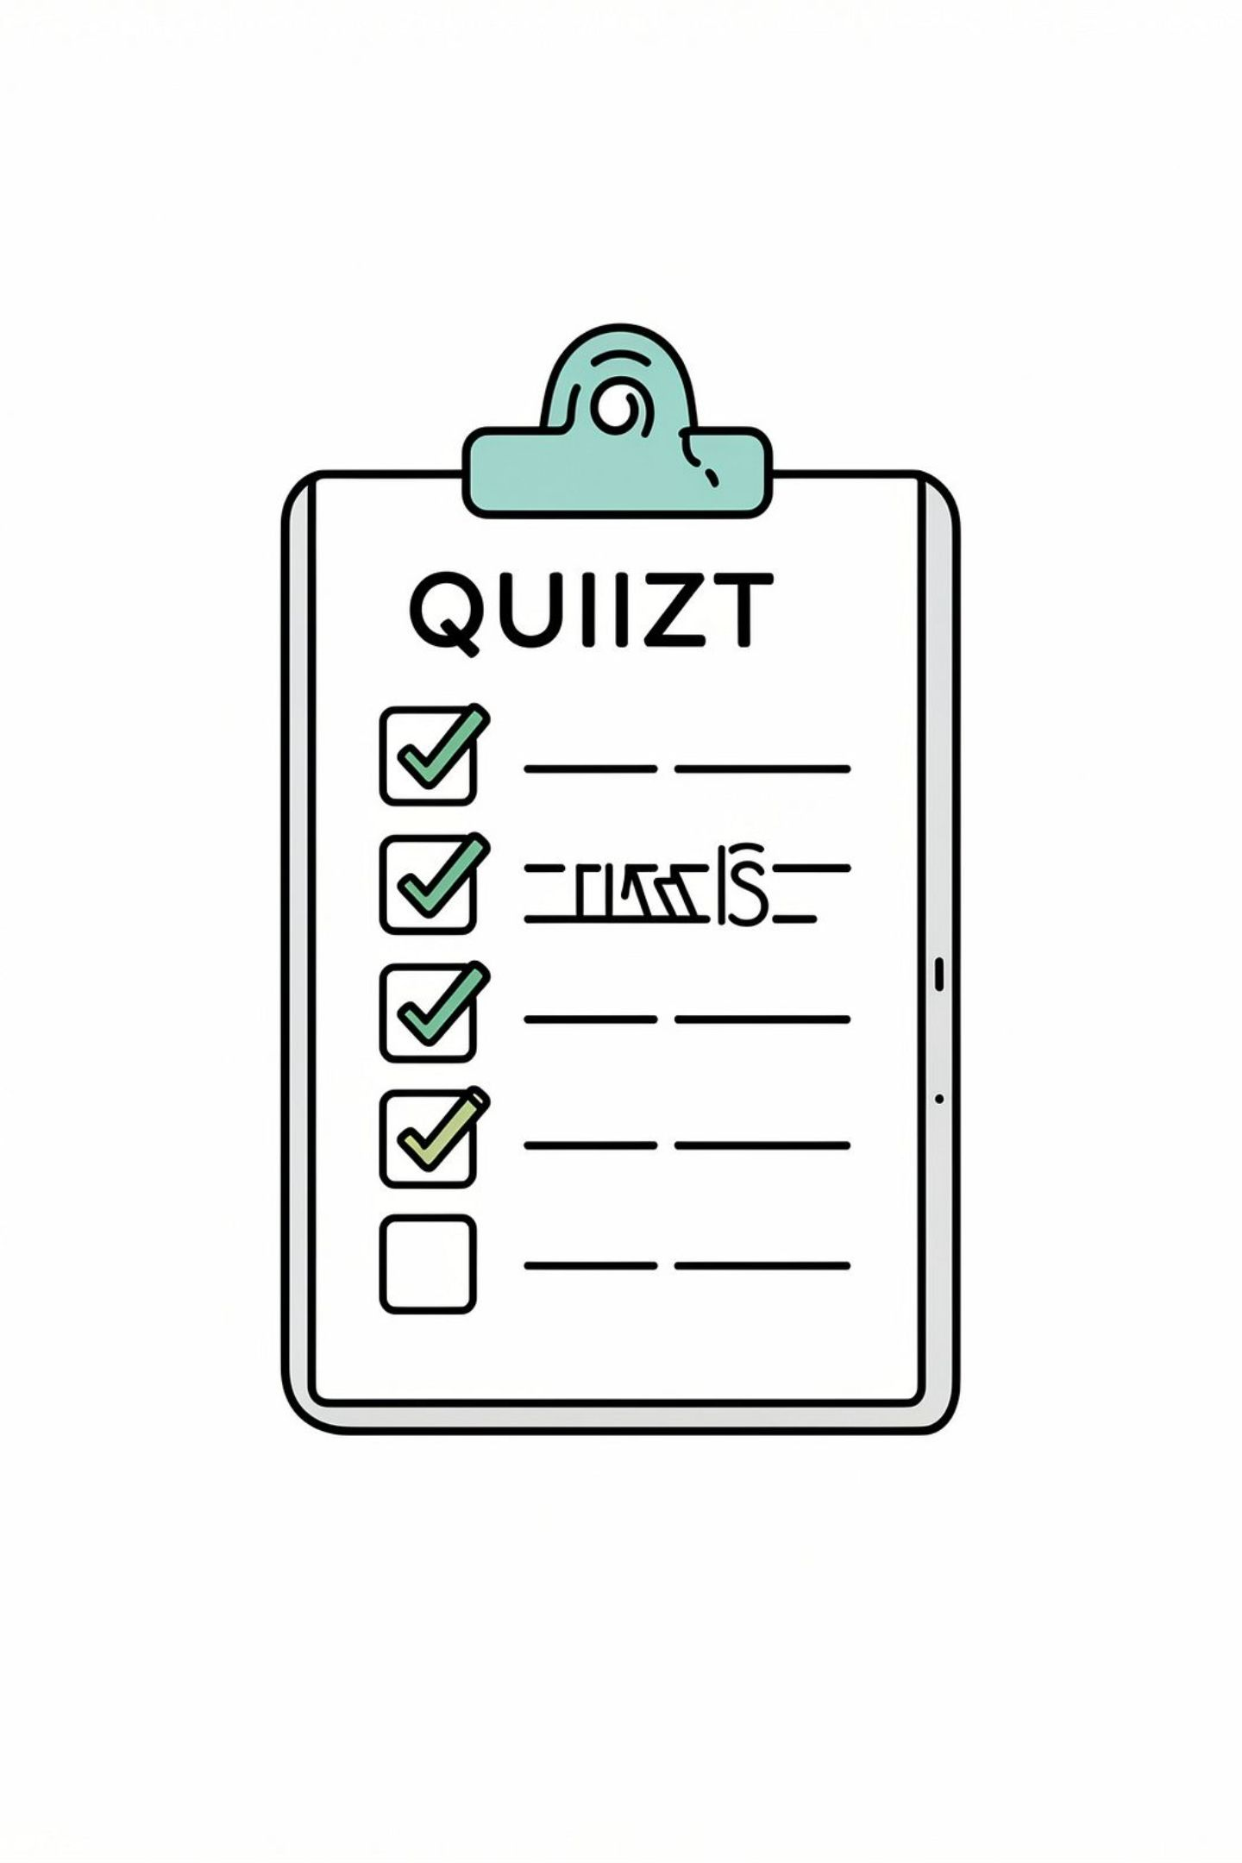

LIVE DEMO
Quizzes & Self-Assessment
Quizlet
StudyFetch
NotebookLM
Generate practice questions & test your knowledge
AI-generated quizzes to identify weak areas
Question-based learning from your uploaded notes

Slide 8


LIVE DEMO
Academic Planning & Research
Gemini Gems
Personalized productivity assistant — study planning, task prioritization & repeatable workflows
Notion
Academic organization, schedules & Master's Roadmap example
ResearchRabbit & Elicit
Discover papers, explore related research & literature

Slide 9
Hands-on Activity
Build your own AI-Assisted Academic Study Pack
01
02
Choose a Concept
Create Notes & Flashcards
Pick one topic from the Introduction to AI notes
Use NotebookLM, StudyFetch, RemNote or Quizlet
03
04
Take a Quiz
Plan & Research
Generate and attempt a self-assessment quiz
Create a study plan with Gemini Gems; explore papers with ResearchRabbit or Elicit

Slide 10


Assessment & Session Outcome
📋 Assessment — 15 min
Individual quiz · 10–15 objective questions · Based on Introduction to AI notes · No AI tools permitted
🎯 By the End, You Will
Learn effectively · Revise better · Organize academics · Explore research
Learn Smarter with AI — Thank you!

